Slide 1

Library Service for
Dooray! Messenger
경영본부 하계인턴
맹산하

Slide 2



PREVIEW
I suggested…
01
02
Dooray! Messenger

Slide 3




What I’ve add
Firestore
Cloud functions
Node.js

Slide 4
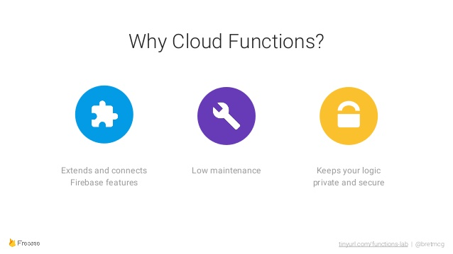

Slide 5
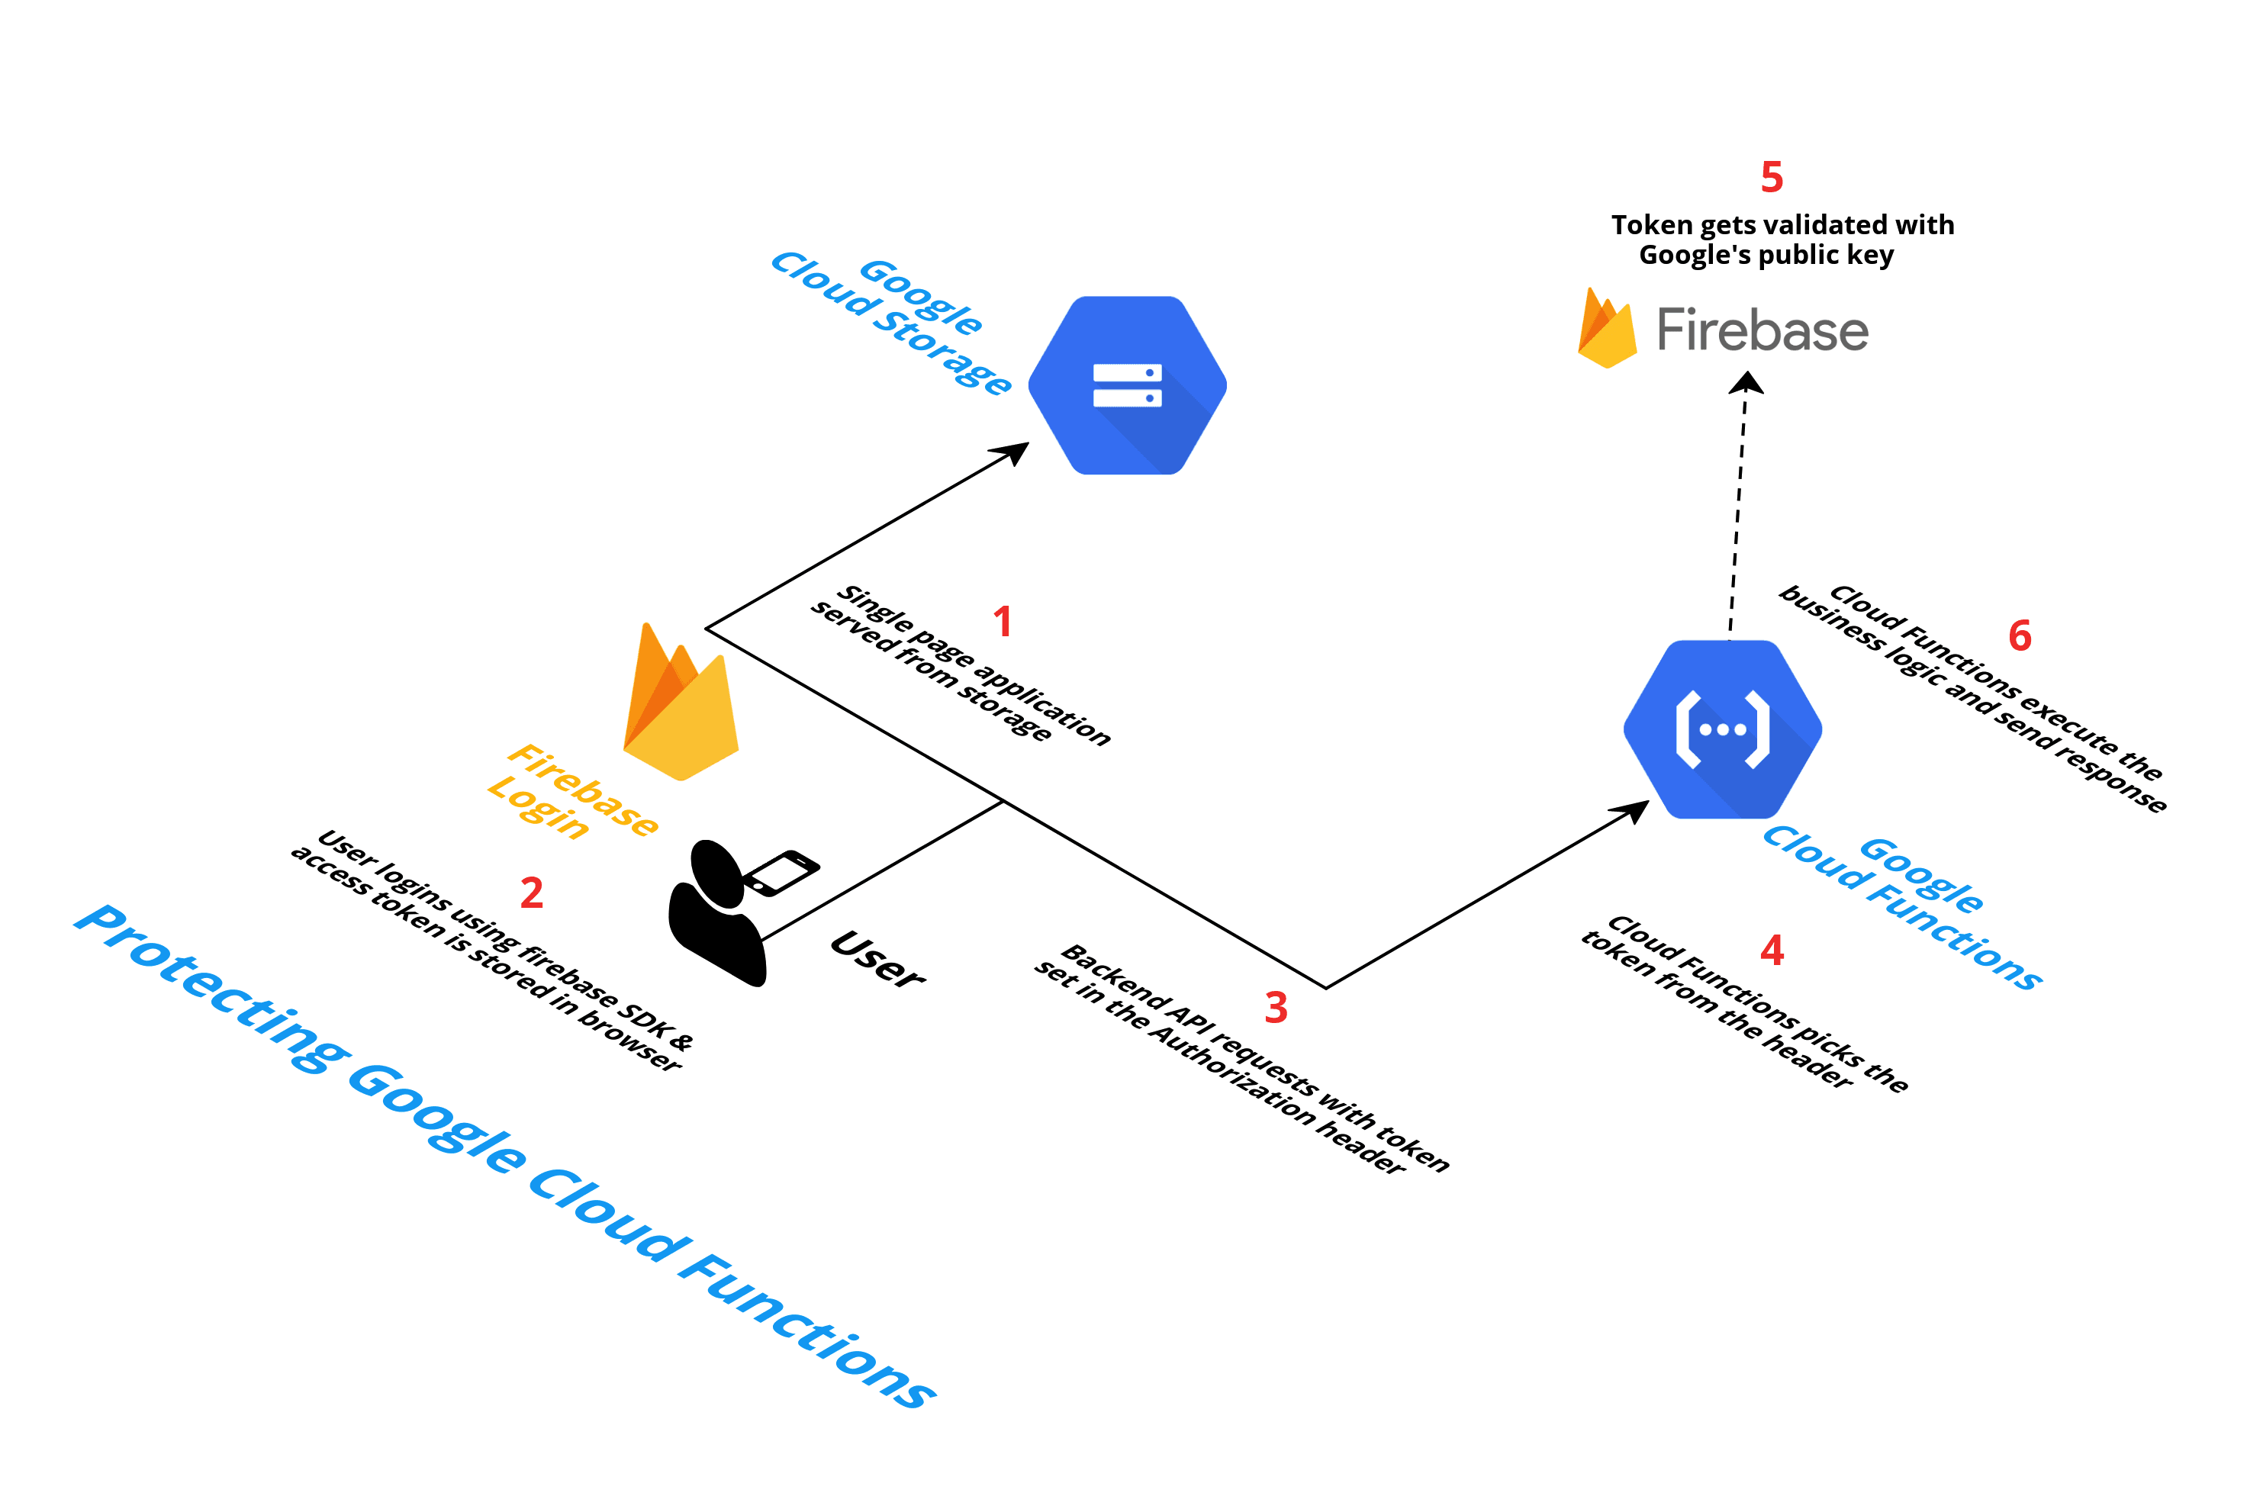

Slide 6
Implementation
Image

Slide 7
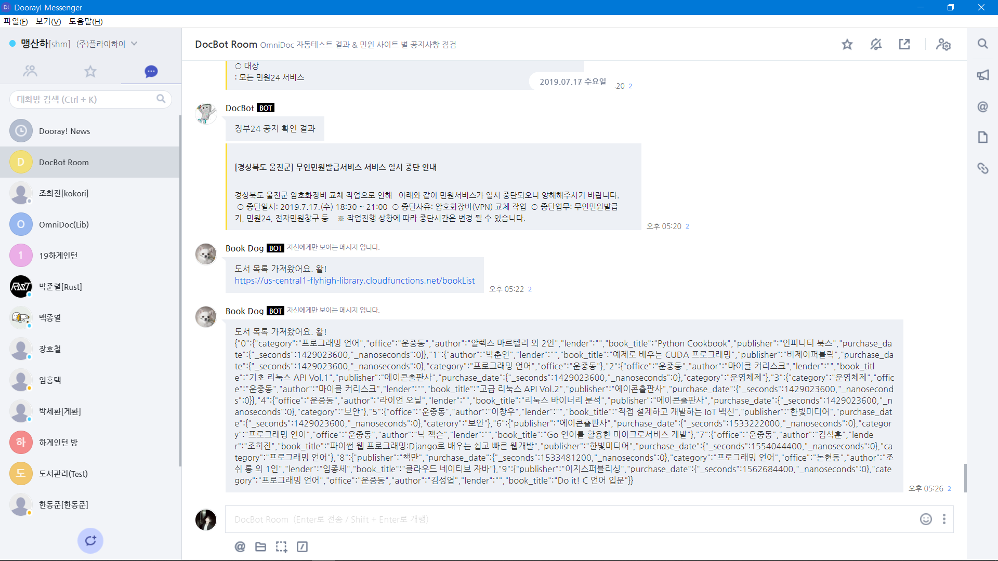

Slide 8
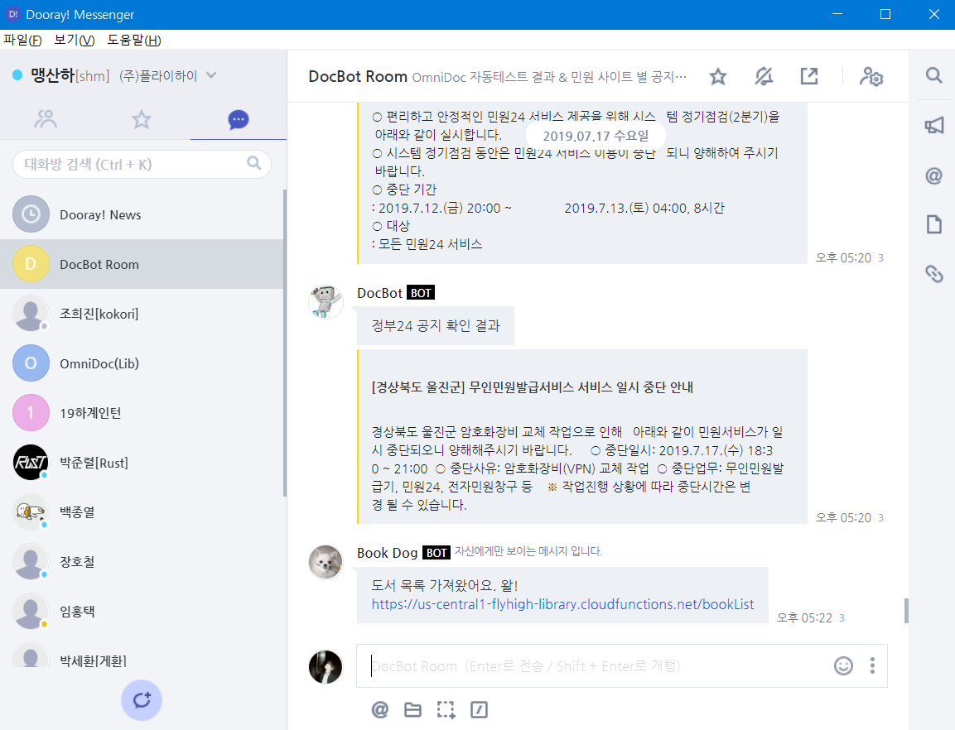

Slide 9
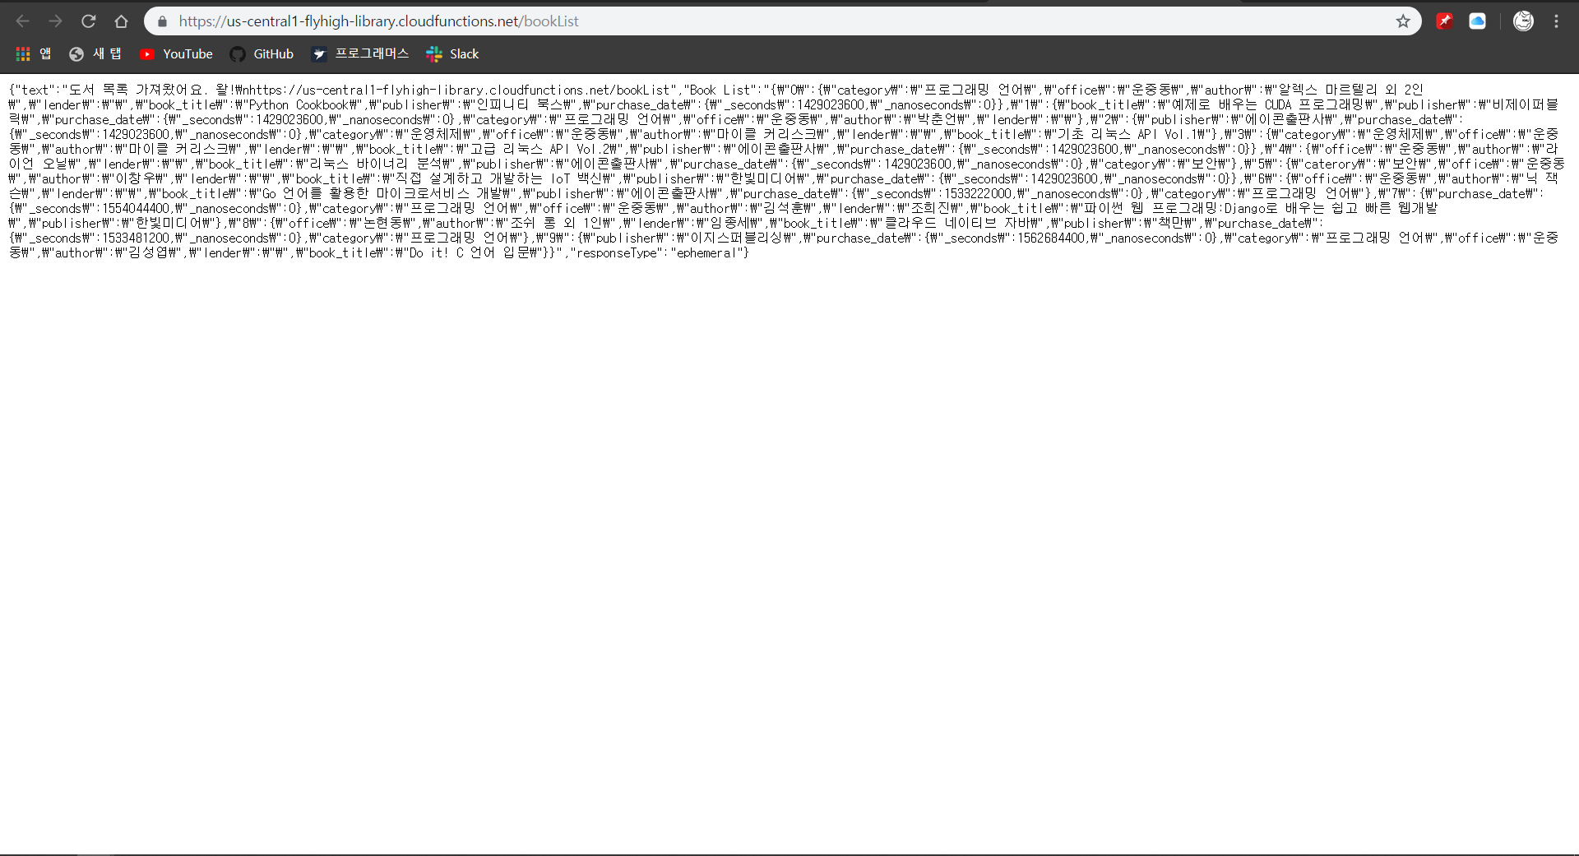

Slide 10
Let me Show
You

Slide 11

delete
modify
canloan
Left / commands
find

Slide 12

Always thinking…

Slide 13

Next Step

Slide 14

What’s Left?
UI
WEB Design
private
Authorization
mobile
Android/iOS
Extension
ML Kit

Slide 15


Thank You
msh01175@gmail.com
010-9750-5676

